Slide 1
Unit 6- Ancient India
Background information

Slide 2
How did the Indus River Valley build cities?
Developed near the river
Grew crops
Extra food gave way for different skills for different types of lives.
Different skills = building of cities

Slide 3
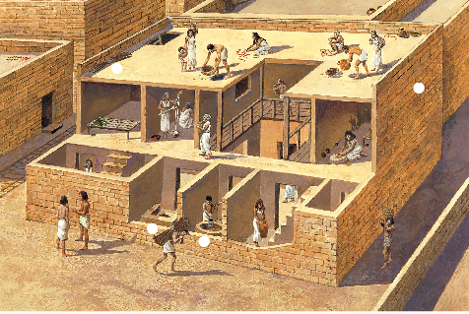
What does Mohenjo-Daro and Harappa mean?
Two major cities of India
Contained 35,000 residents
Fortress built at the west end
Very advanced homes
Indoor bathrooms with pipes for waste to flow outside the cities

Slide 4
How did Aryans influence India?
Most of the original people left due to severe drought.
New people came and resettled in India-Aryans
Spoke Indo-European language
Aryans mixed with original people and a new culture was created
Aryans lived in tribes led by a raja (prince)
Raja’s created own kingdoms and fought each other for farm land
Aryans developed written language, Sanskrit
All writings put together into a sacred text called, vedas

Slide 5
How was society organized?
Each 4 part Social class in India is part of a varna
People are members of varna if they are BORN into it.
People must remain in that caste
Specific jobs for each
Marriage must remain in same caste
4 part caste system
Brahmin
Kshatriyas
Vaisyas
Sudras
Last part of Caste- Untouchables

Slide 6
What was family like in ancient India?
Family was everything!
Everyone lived together
Elders were respected
Men had more rights than women
Boys in the family had gurus (teacher)
Men could marry after 12 years of school
Parents arranged marriages-past and present
Married in their teens
Divorce not allowed

Slide 7
What is a class system?
Grouping people according to their wealth, income education and type of occupation
People may be born in these different groups
Can move up through the groups for many different reasons

