Slide 1
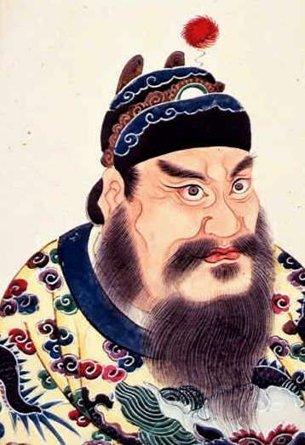
Unify with Shi Huangdi
6.6.5

Slide 2
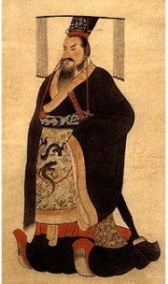
About Shi Huangdi
Occupation: Emperor of China
Reign (ruled): 221 BCE to 210 BCE
Born: 259 BCE
Died: 210 BCE
Real Name: Prince Zheng
New Name: Shi Huangdi
Best Known for: First Emperor of China, established the Qin Dynasty

Slide 3
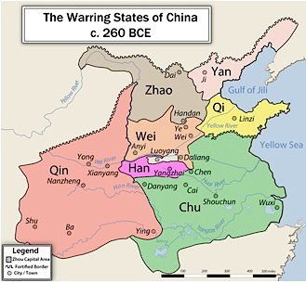
Era of Warring States
Born during the chaos
Became king at 13
Ruled independently by 22 and wanted to end chaos and unify China
Started Control with Qin, then set out to conquer more
Once took control, declared himself
emperor and changed name.

Slide 4
Organizing the Empire with Accomplishments
Government:
Divided into government units, provinces,36 of them
Government positions given by people abilities
Economy & Writing:
Unified $ and units of measurements
One standard of writing for all
Construction:
Built roads and canals, using standardize measurement
Began building Great Wall of China-to protect “invaders” from the North

Slide 5
The Great Wall
Forced hundreds of thousands of farmers to leave their fields to work on the wall.
Thousands of laborers died before the project was completed.
The finished wall, the Great Wall of China, was built mainly on the northern slopes of mountains, using stone, sand, and rubble.
However, Qin did not build the wall that stands today.
The Great Wall today consists of a series of walls and towers built during the Ming dynasty beginning in the late 1400s.

Slide 6
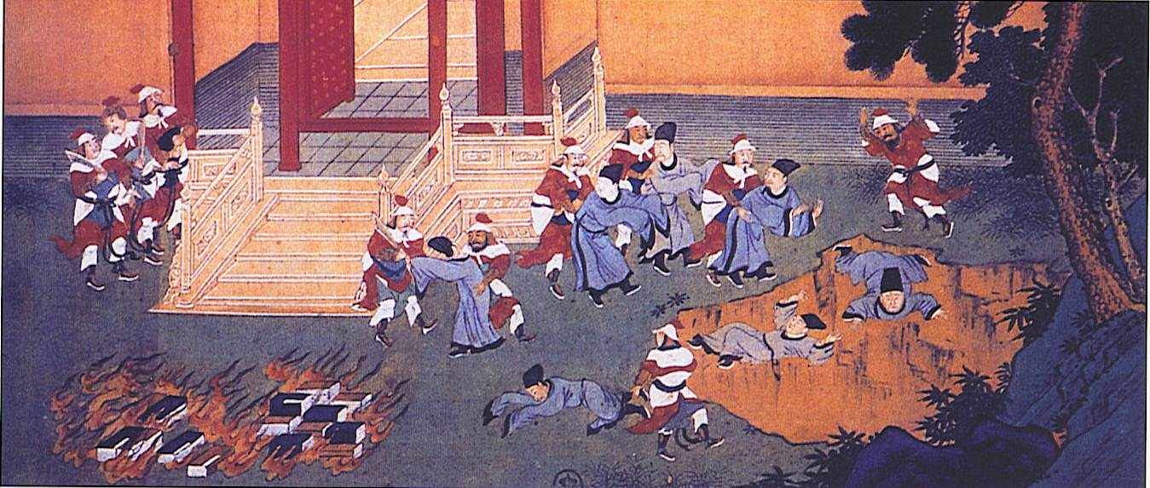
Shi Huangdi… A tyrant?
Outlawed most religions
Stuck with Legalism only
Book Burning
Censored ideas that did not work for his ruling
Scholars
Killed if they refused to follow Shi Huangdi’s ideas

Slide 7
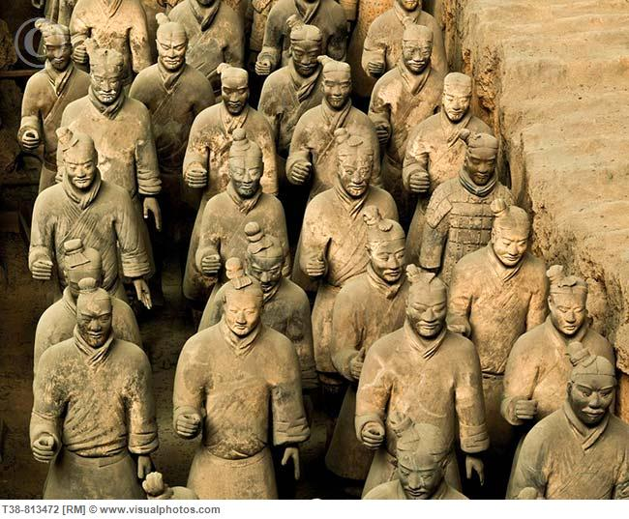
Tomb of Shi Huangdi
Over 700,000 workers constructed his tomb
8,000 soldiers, horses and chariots created to protect him in the afterlife
http://youtu.be/c5LDHCkG0oQ

Slide 8
Death of Shi Huangdi
Died while traveling on tour
Second Son was supposed to take over
Peasant of Qin Dynasty rebelled and others joined the rebellion
Peasant became new emperor and called his dynasty, Han Dynasty

Slide 9
Blossom with the Han Dynasty
6.6.6
EQ #4: How did the Han Dynasty strengthen and expand China?

Slide 10
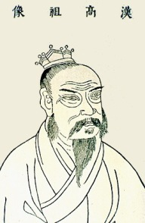
Peasant turn Emperor
Liu Bang, (leo-bong)- Rebel peasant in the Qin Dynasty founded the Han Dynasty
Han dynasty lasted from 206 BCE-220 BCE

Slide 11
Expansion with the Han dynasty…
During the Han dynasty there was peace, stability and success
The Han Dynasty had a strong military to help expand the empire to new territories.
Expansion allowed for international trade with countries like India, and Rome.

Slide 12
The Silk Road
The Chinese exported such goods as silk, spices, and jade.
The Chinese imported new products and ideas - including Buddhism
Much of the trade occurred locally in small trade centers throughout Asia
First time China began to have contact with people outside the Great Wall.

Slide 13
Confucianism makes a comeback…
Han Dynasty moved away from the idea of Legalism and based their ruling through the ideas of Confucianism.
Government officials were selected based on merit and knowledge of Confucianism.
Made for more to follow Confucianism to have a chance to be a government official.

Slide 14
Travelers and Talkers Assignment:
Each Table will be given a social group-
a. Every student will need to read about their person on the social pyramid and write down a brief summary of who they are, what do they do, how do they participate within the trading system, and why are they an important part to China and The Silk Roads.
b. Two students will be travelers and Two Students will be talkers, but again everyone needs to have the information on their group.
c. Talkers will remain at the table to explain to other travelers who their social class is and what they do, how are they apart of the trading system and why they are important to Chinese Society. (Talkers will have 1 poster-where they will design their social class and draw a picture of their group to show the travelers)
d. Travelers will travel to other tables to discuss their findings about their social class to the talkers in other provinces. They will be explaining the same thing as the talkers, but they are traveling to explain their findings. (Travelers will have their own little posters with their information and picture to show the talkers they travel to)

